Slide 1
Oxide Etch Rate Prediction Under Varying O₂
Using Stepwise Forward Selection of Principal Components
Seunghyun Kim, Haeun Roh, Seonghoon Yoon
Department of Chemical Engineering,
Sungkyunkwan University (SKKU)
2026.01.27

Slide 2
Outline
Introduction
Issue
Previous Approaches
Approach
Equipments & Method
Results
Discussion
Suggestion
References

Slide 3
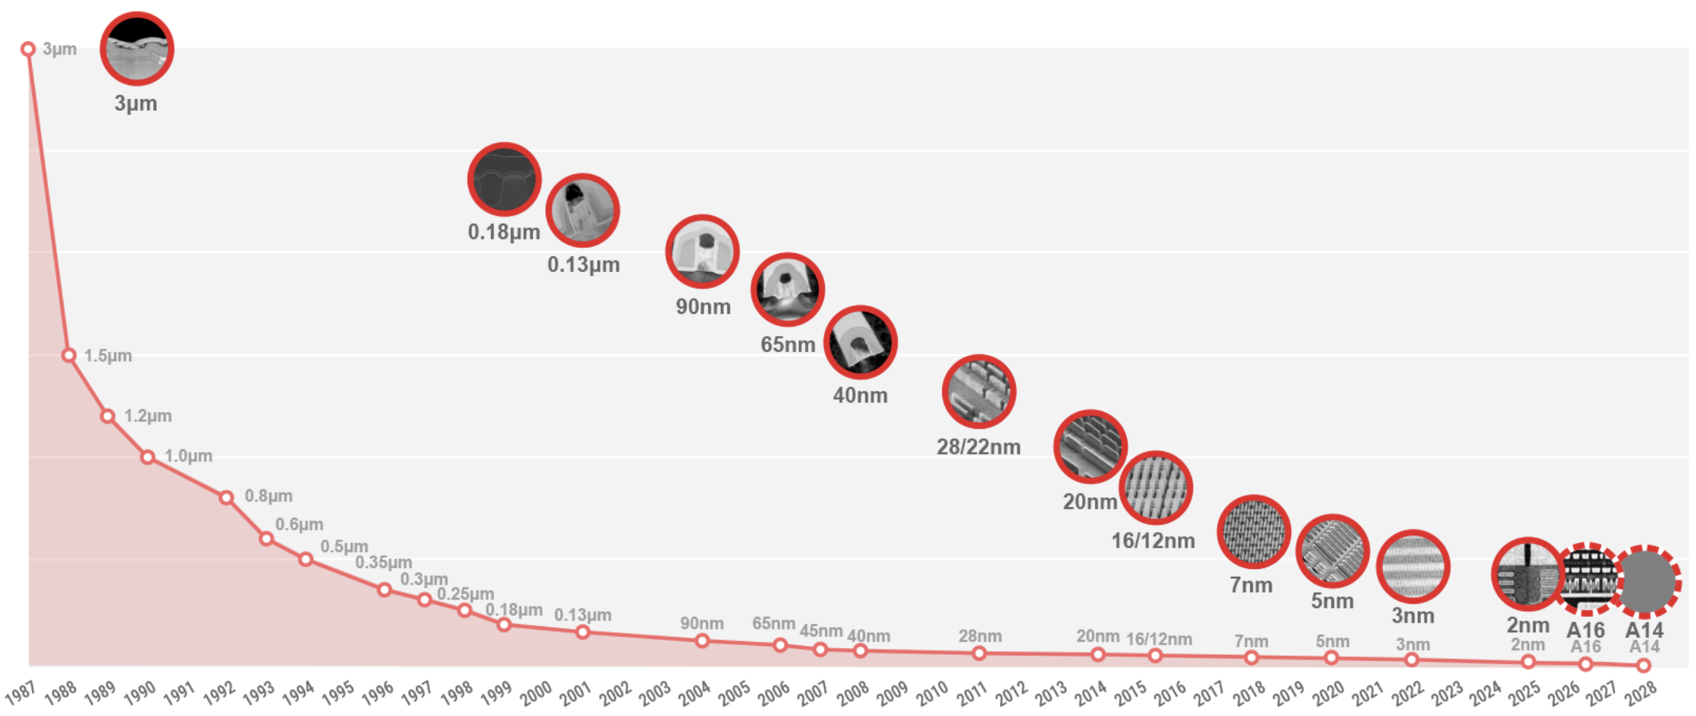
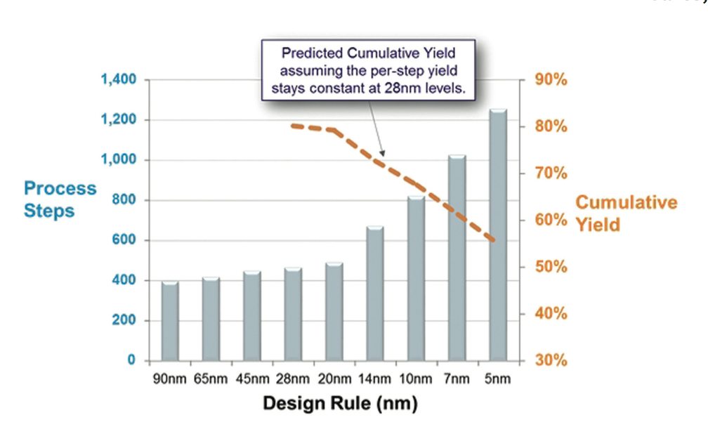
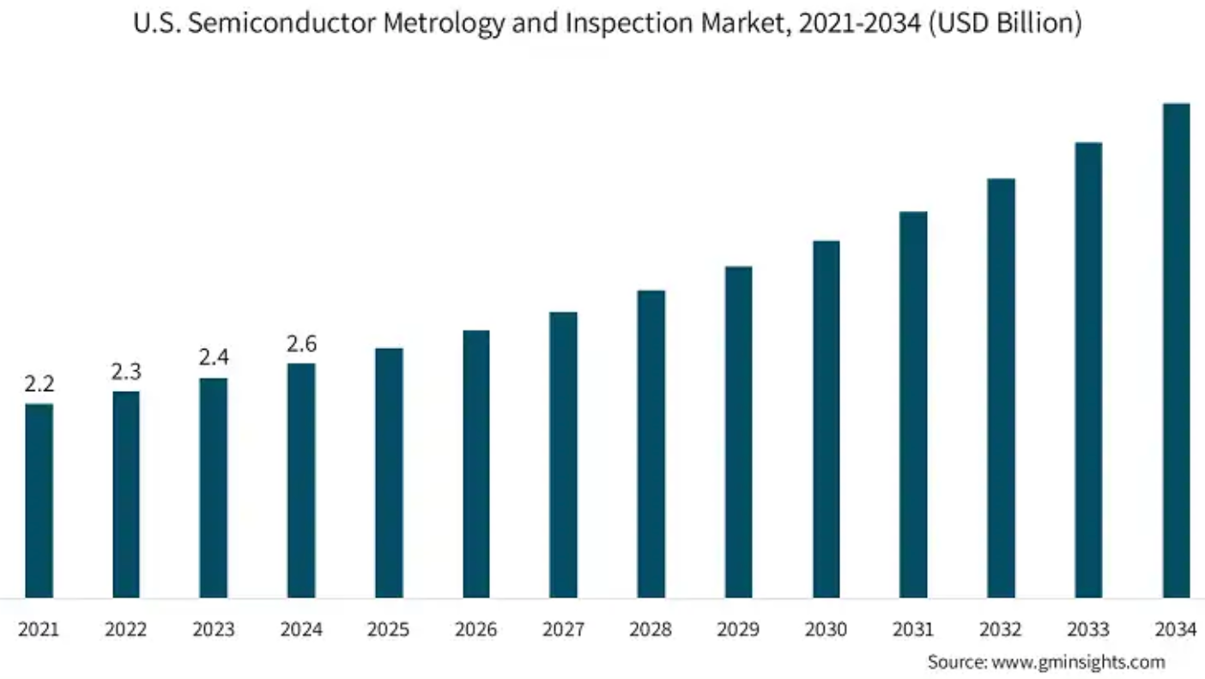
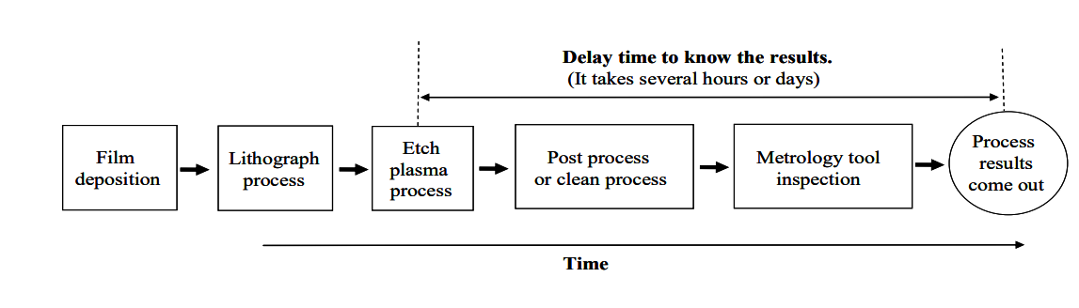
Introduction: Need for Real-Time Process Monitoring
Trend of Semiconductor Manufacturing
Yield Reduction with Increasing Process Steps
https://www.tsmc.com/english/dedicatedFoundry/technology/logic
KLA-Tencor (2018)
Precision process control is required to implement fine scaling and 3D-structured processes.
Investment in Process Monitoring
Limit of Process Monitoring
Semiconductor Metrology Inspection Market
Delay time of conventional process monitoring
Source: https://www.gminsights.com/industry-analysis/semiconductor-metrology-and-inspection-market
Yang et.al., Sensors, 10, 5703
Real-time monitoring technology utilizing sensors is essential.
Notes:
반도체 소자 구조가 미세화 되고 복잡해지고, Yield 감소 + 공정 단계 증가, Real-time monitoring 필요성, Conventional metrology의 delay -> 공정은 점점 복잡해지는데, 측정은 느리다. 따라서 예측이 필요하다

Slide 4
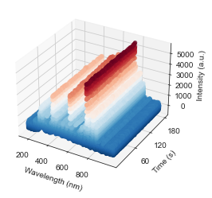
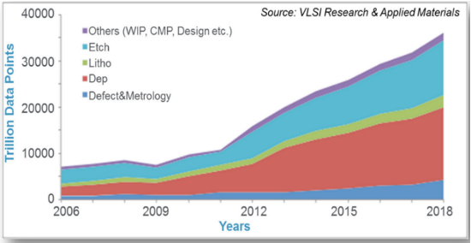
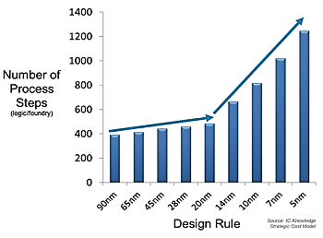
Issue 1:Difficulties of Real-Time Monitoring
Increasing Volume of Plasma Data
High Dimensionality of Plasma Data
Real-time processing is hindered by high dimensionality and massive data volume.

Slide 5
Issue 2: Difficulty in Data Interpretation
Calculation of PI
Process Conditions
Process Result
Plasma Info
n_{x}
n_{e}
T_{e}
Ion energy
Ion flux
…
OES Intensity
+
Vi data
Voltage
Current
Impedance
…
RF power
Pressure
Gas ratio
Flow rate
Etch rate
Etch profile
Uniformity
Etch selectivity
The highly non-linear nature of plasma makes it difficult to interpret sensor data in real-time, hindering immediate prediction of process results.

Slide 6
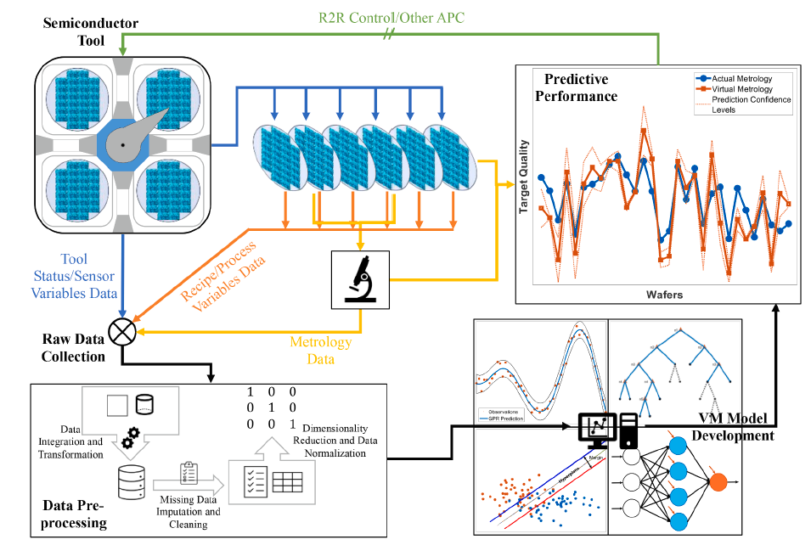
Virtual Metrology in semiconductor
Predict process properties and results for R2R control
Based on EES/Sensor/Process data
Utilizes statistical and ML methods
Expert Syst Appl, 249, 123559 (2024)
Virtual metrology provides a structured framework to bypass measurement delays and enable real-time R2R control.

Slide 7
Previous Approaches
Category | Method(Algorithm) | Input Data | Output Data | Reference
VM (PI-based regression) | MLR + SVS | EES + PI-OES + PI_Density | etch depth, bowing CD 등 etch profile | Kwon et al., 2021
VM (OES feature → regression) | PLS, SVR | OES spectral features | CD after RIE | Chien et al., 2021 (JVST B)
Process monitoring (VI) | correlation/monitoring | VI probe | etch result correlation | Song et al., 2021
Plasma diagnosis (VI ↔ plasma) | impedance analysis | VI probe(impedance) | Ar plasma parameter correlation | Lee et al., 2021
VM (OES + VI–based PI regression) | PCF/SVS/PCA + MLR | OES + VI probe | Etch result correlation, valuable PI variables​ | This work

Slide 8
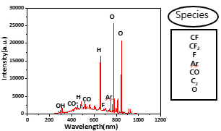
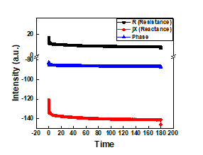
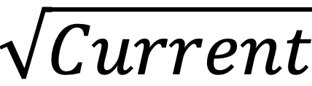
Flowchart of Virtual Metrology
Raw OES/VI Data
Feature Filtering
Statistical Feature Selection
SVS- Forward Selection
OES Raw Data (1024)
OES Variables (12)
Feature selection method (TOP5)
Actinometry
→ n_{CO,} n_{CF2,} n_{CF}, n_{F}, n_{o}
Ar Line Ratio
→ ne, Te
Filter
Wrapper
PCA
PCF
SVS
Modeling
Hybrid Model
OES (dominant radical data)
PC (subtle process data)
R² = 0.88
Resolved dependency issues using PC variables
128-1104nm wavelength
VI Variables (10)
VI Raw Data (130)
Energy Delivery
Power, Reflected power,
Couplingefficiency
Ion Accereration (Energy)
Voltage, Phase
Ion Flux (Density)
Current, Impedance
Surface Reaction
EffectivePower,
Voltage * current,
Voltage *
Result : OES (8) + PCA (5)
Max R² < 0.85
High inter-variable dependency
OES dominance masks VI signals
F1(2MHz)/F2(13.56MHz)
Harmonics(H2-H5)
Power, Forward/Reflected Power,
Energy, Standing wave ratio
Voltage, Phase, Harmonic Phase
Current: Amps, Mag, Phase, Real, Imag
Impedance : Mag, Phase, Real, Imag
Notes:
F1 Power Watts
F1 Forward Power Watts
F1 Reflected Power Watts
F1 Energy Joules
F1 Standing Wave Ratio
F1 Voltage Volts
F1 Current Amps
F1 Phase Degrees
F1 Harmonic Phase Degrees
F1 Impedance Magnitude Ohms
F1 Impedance Phase Degrees
F1 Impedance Real Ohms
F1 Impedance Imaginary Ohms
F1 Current Magnitude Amps
F1 Current Phase Degrees
F1 Current Real Amps
F1 Current Imaginary Amps
F1 Gamma Reflection Coefficient Magnitude
F1 Gamma Reflection Coefficient Phase Degrees
F1 Gamma Reflection Coefficient Real
F1 Gamma Reflection Coefficient Imaginary

Slide 9
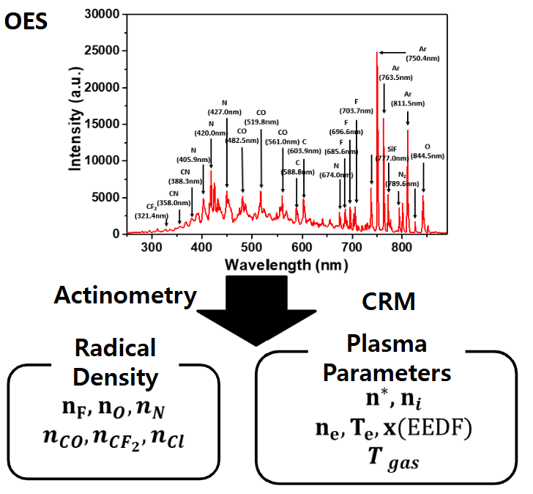
Approaches
OES 기반 플라즈마 화학 및 여기 정보 도출
Actinometry: Radical density ratio
  Reference: Ar (750.49nm)
  F (703.57, 686.60nm), O (777.03, 700.65nm), CF₂ (251.86, 262.80nm), CF (258.12, 724.06nm), CO (645.4, 644.44nm)
Dissociation
  e⁻ + CF4 → CF3⁺ + F + 2e⁻
  e⁻ + CF4 → CF2 + 2F + e⁻
Surface Reaction (SiO2 Etching)
  SiO2(s) + 4F(g) → SiF4(g)↑ + O2(g)
Oxygen Reaction (Polymer Removal)
  C(s) + O(g) → CO(g)↑
  CFx(s) + O(g) → COFx(g)↑
Line-ratio
n_{CO,} n_{CF2,} n_{CF},
n_{F} , n_{o}
n_{e} , T_{e}
A technique to estimate the relative change in radical density (nX) by comparing the emission intensity of the target
radical to that of a trace amount of inert gas (Ar) added to the plasma.
Used PCF to identify the wavelength combinations that exhibit the strongest linear correlation with the actual Etch Rate.

Slide 10
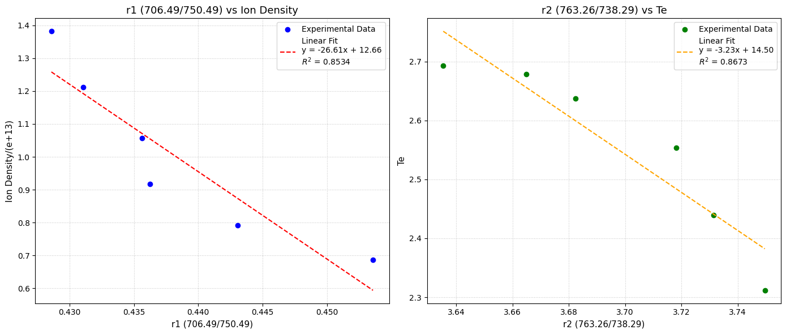
Approaches : Line-Ratio Selection
Selection of n_{e} and T_{e} sensitive line ratios through ion probe
Ion Density(n_{e}) Analysis
r1 vs Ion Density Correlation : -0.92 Selected n_{e} : (706.49/750.49)
Electron Temperature(T_{e} )
r2 vs T_{e} Correlation : -0.93 Selected T_{e} : (763.26/738.29)
A non-invasive diagnostic method to monitor the behavior of electron temperature (Te) and electron density (ne) by calculating the intensity ratio ( ) of two Ar emission lines with different excitation energies.
PCF validation identified the highest correlation between Slope per Intensity and Ion Probe data.

Slide 11
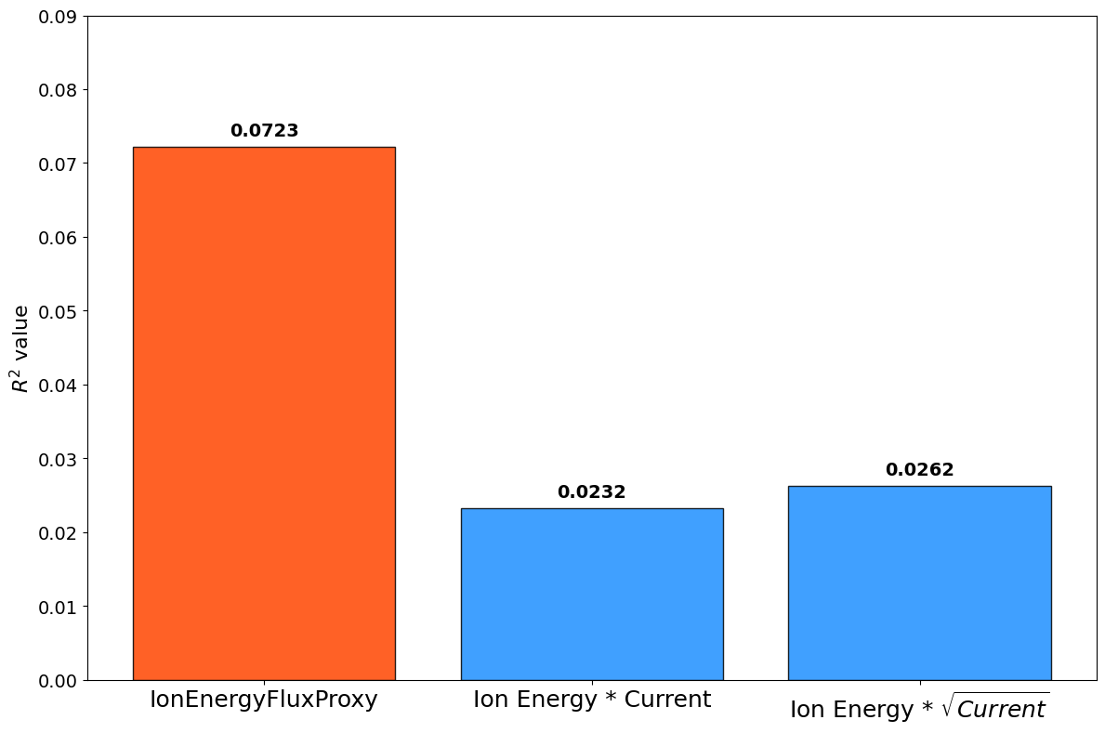
Approaches
R² Comparison for Different Ion Flux Approximation
VI 기반 플라즈마 물리적 거동 프록시 변수 정의
Voltage : Ion energy (Bombardment)
Phase : Energy transfer efficiency (Capacitive/Inductive)
Impedence(Z=V/I) & Current : RF power coupling efficiency
Combination of parameters
  CouplingEfficiency = 1-(Reflected/Power)
  EffectivePower = Voltage/Real Ohm
  Voltage * Current
  Voltage *
Surface Kinetics in Fluorine‐Based Plasma Etching
① Ion-enhanced
Ar⁺
Ar⁺
Ar⁺
① Ion-enhanced
Ar⁺
Ar⁺
Ar⁺
CFₓ⁺
CFₓ⁺
③ Physical sputter
CFₓ⁺
CFₓ⁺
③ Physical sputter
② Spontaneous reaction
② Spontaneous reaction
SiO₂(s)​+4F(g)​→SiF₄(g)​+O₂(g)​
SiO₂(s)​+4F(g)​→SiF₄(g)​+O₂(g)​
Si_{3​}N₄(s)​+12F(g)​→3SiF₄(g)​+2N₂(g)​
Si_{3​}N₄(s)​+12F(g)​→3SiF₄(g)​+2N₂(g)​

Slide 12
Flowchart of Virtual Metrology
Raw OES/VI Data
Feature Filtering
Statistical Feature Selection
SVS- Forward Selection
OES Raw Data (1024)
OES Variables (12)
Feature selection method (TOP5)
Actinometry
→ n_{CO,} n_{CF2,} n_{CF}, n_{F}, n_{o}
Ar Line Ratio
→ ne, Te
Filter
Wrapper
PCA
PCF
SVS
Modeling
Hybrid Model
OES (dominant radical data)
PC (subtle process data)
R² = 0.88
Resolved dependency issues using PC variables
128-1104nm wavelength
VI Variables (10)
VI Raw Data (130)
Energy Delivery
Power, Reflected power,
CouplingEfficiency
Ion Accereration (Energy)
Voltage, Phase
Ion Flux (Density)
Current, Impedance
Surface Reaction
EffectivePower,
Voltage * current,
Voltage *
Result : OES (8) + PCA (5)
Max R² < 0.85
High inter-variable dependency
OES dominance masks VI signals
→ Combining OES with PCA
F1(2MHz)/F2(13.56MHz)
Harmonics(H2-H5)
Power, Forward/Reflected Power,
Energy, Standing wave ratio
Voltage, Phase, Harmonic Phase
Current: Amps, Mag, Phase, Real, Imag
Impedance : Mag, Phase, Real, Imag
Notes:
F1 Power Watts
F1 Forward Power Watts
F1 Reflected Power Watts
F1 Energy Joules
F1 Standing Wave Ratio
F1 Voltage Volts
F1 Current Amps
F1 Phase Degrees
F1 Harmonic Phase Degrees
F1 Impedance Magnitude Ohms
F1 Impedance Phase Degrees
F1 Impedance Real Ohms
F1 Impedance Imaginary Ohms
F1 Current Magnitude Amps
F1 Current Phase Degrees
F1 Current Real Amps
F1 Current Imaginary Amps
F1 Gamma Reflection Coefficient Magnitude
F1 Gamma Reflection Coefficient Phase Degrees
F1 Gamma Reflection Coefficient Real
F1 Gamma Reflection Coefficient Imaginary

Slide 13
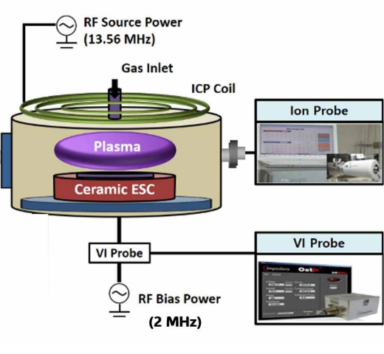
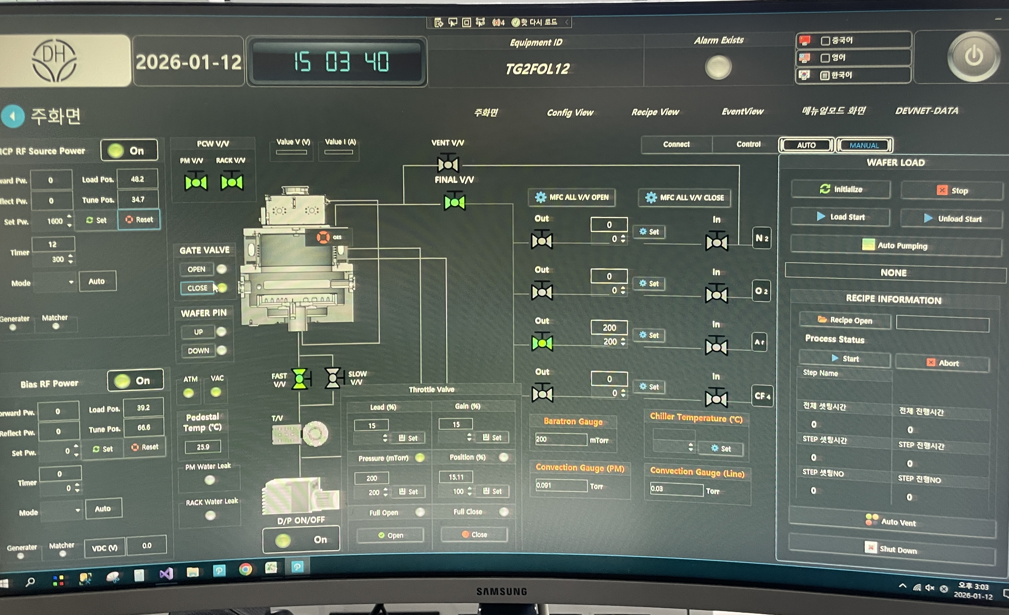
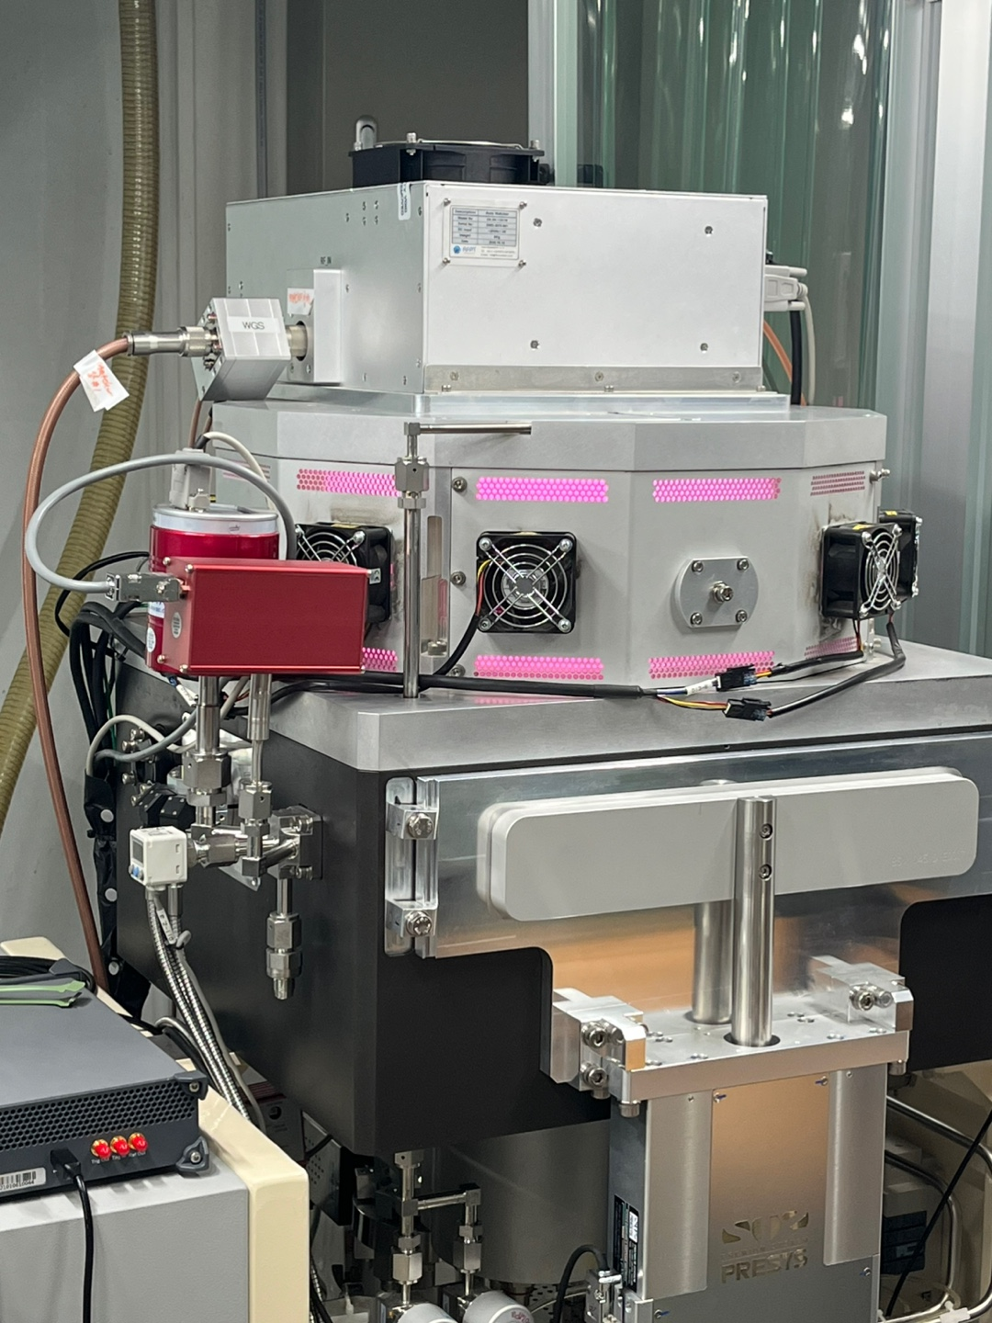
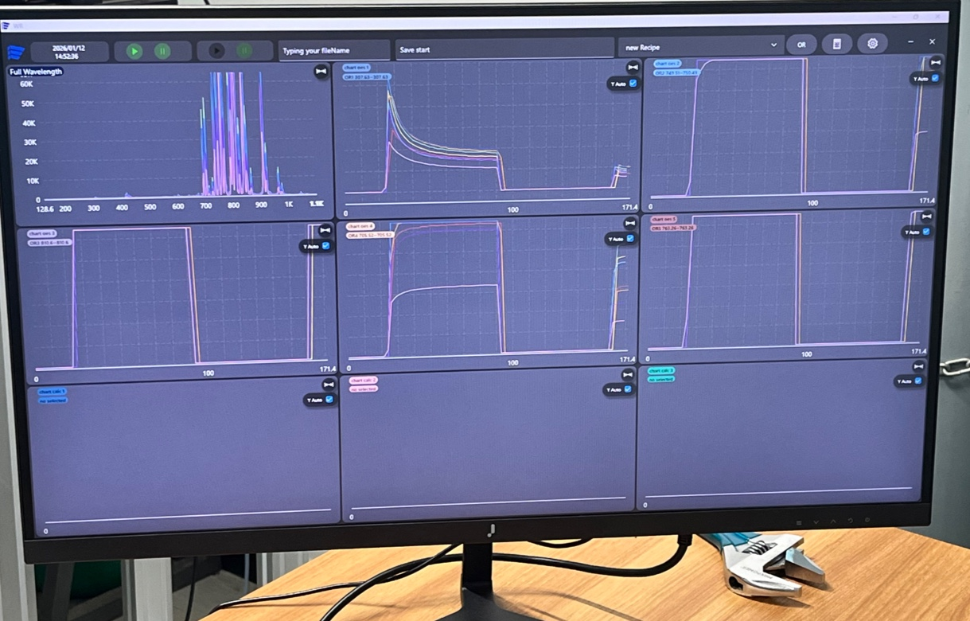
Equipments & Method
ICP (Inductively Coupled Plasma)
VI probe: Bias RF power delivery line
 | Set Value | Step
Source | 1000W~1400W | 200W
Bias | 200W, 200mTorr | -
Etching Target | SiO₂ | -
Ar | 200 sccm | -
CF₄ | 200 ~ 100 sccm | 25 sccm
O₂ | 50 ~ 150 sccm | 25 sccm
OES range | 128.55 ~ 1104.37 nm | -
Frequency | 2 MHz | -

Slide 14
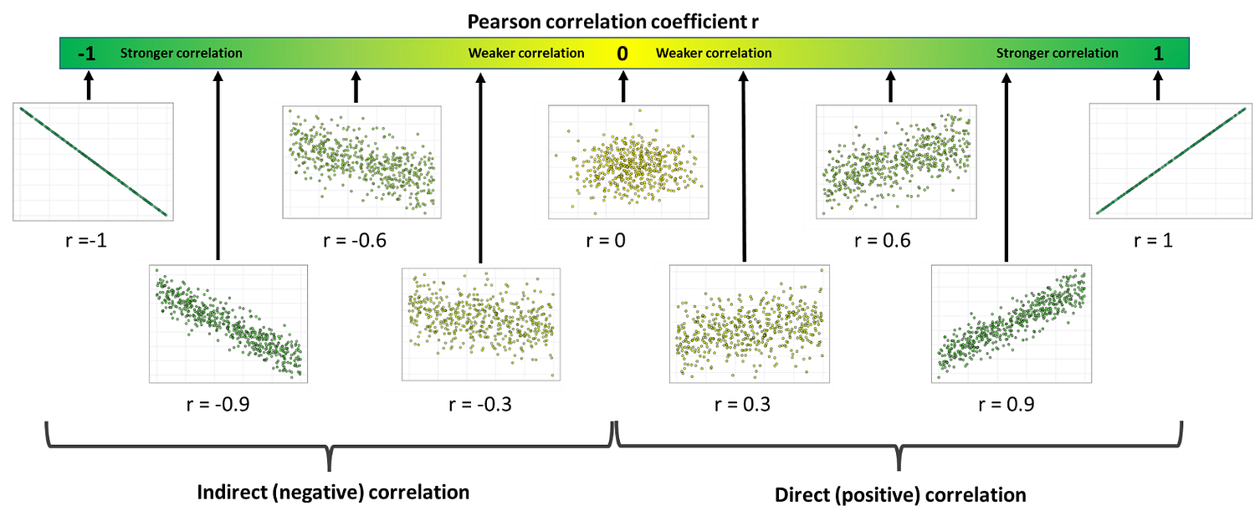
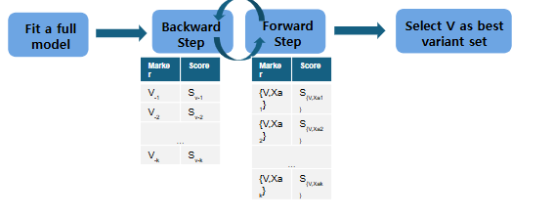
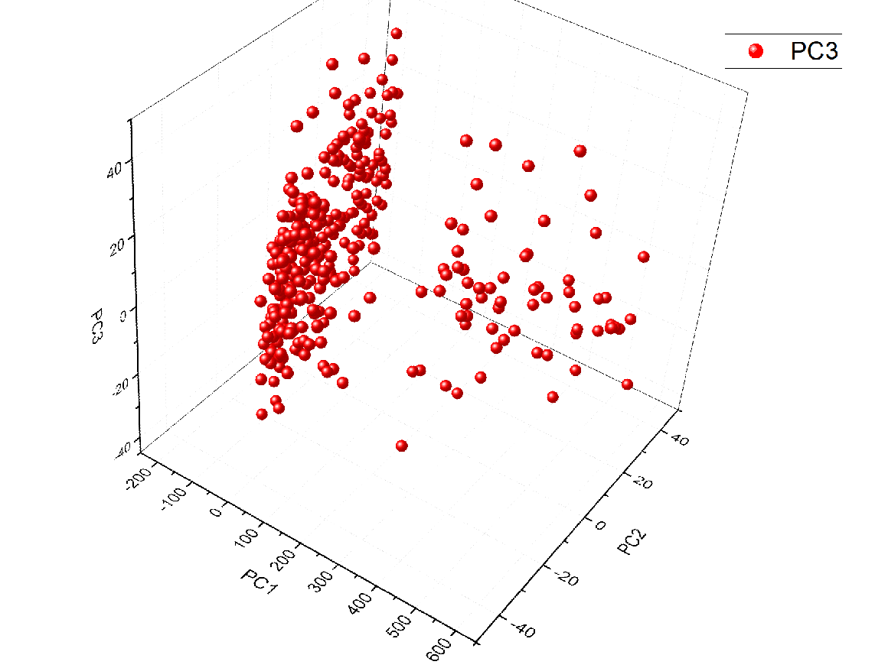
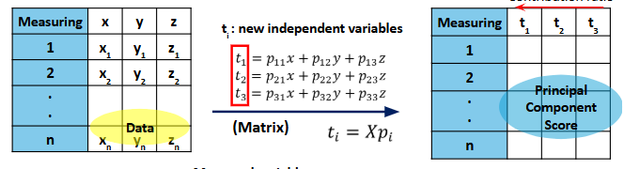
Approaches: Feature Selection Methods
PCF (Pearson Correlation Filter) | 변수 간 1:1 선형 상관성 산출 → 개별 변수의 직접적 영향력 파악
SVS (Stepwise Vector Selection) | 모든 데이터 세트를 학습, 평가 → 최적의 feature 조합 도출
PCA (Principal Component Analysis) | 고차원 데이터 행렬의 차원 분해
Each method is employed with distinct strategies to optimize VM performance.

Slide 15
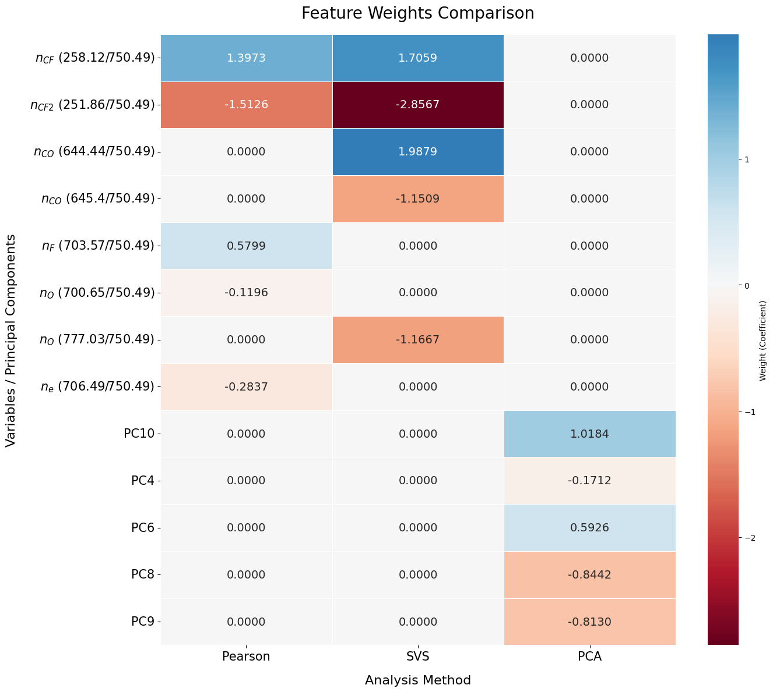
Results : Feature Selection & Weight Comparison
Comparison of Feature Selection Across Models
Model | Selected Top 5 Variables
Pearson | nCF2, nCF, nF, ne, nO
SVS | nCF2, nco(644), nCF, nO, nco(645)
PCA (Best 5 PCs) | PC10, PC8, PC9, PC6, PC4
Pearson & SVS: Targeting OES-based features.
PCA: Integrating OES (Chemical) + VI (Physical)
Dominant OES selection reflects high sensitivity to radical density variations.

Slide 16
Flowchart of Virtual Metrology
Raw OES/VI Data
Feature Filtering
Statistical Feature Selection
SVS- Forward Selection
OES Raw Data (1024)
OES Variables (12)
Feature selection method (TOP5)
Actinometry
→ n_{CO,} n_{CF2,} n_{CF}, n_{F}, n_{o}
Ar Line Ratio
→ ne, Te
Filter
Wrapper
PCA
PCF
SVS
Modeling
Hybrid Model
OES (dominant radical data)
PC (subtle process data)
R² = 0.88
Resolved dependency issues using PC variables
128-1104nm wavelength
VI Variables (10)
VI Raw Data (130)
Energy Delivery
Power, Reflected power,
Couplingefficiency
Ion Accereration (Energy)
Voltage, Phase
Ion Flux (Density)
Current, Impedance
Surface Reaction
EffectivePower,
Voltage * current,
Voltage *
Result : OES (8) + PCA (5)
Max R² < 0.85
High inter-variable dependency
OES dominance masks VI signals
→ Combining OES with PCA
F1(2MHz)/F2(13.56MHz)
Harmonics(H2-H5)
Power, Forward/Reflected Power,
Energy, Standing wave ratio
Voltage, Phase, Harmonic Phase
Current: Amps, Mag, Phase, Real, Imag
Impedance : Mag, Phase, Real, Imag
Notes:
F1 Power Watts
F1 Forward Power Watts
F1 Reflected Power Watts
F1 Energy Joules
F1 Standing Wave Ratio
F1 Voltage Volts
F1 Current Amps
F1 Phase Degrees
F1 Harmonic Phase Degrees
F1 Impedance Magnitude Ohms
F1 Impedance Phase Degrees
F1 Impedance Real Ohms
F1 Impedance Imaginary Ohms
F1 Current Magnitude Amps
F1 Current Phase Degrees
F1 Current Real Amps
F1 Current Imaginary Amps
F1 Gamma Reflection Coefficient Magnitude
F1 Gamma Reflection Coefficient Phase Degrees
F1 Gamma Reflection Coefficient Real
F1 Gamma Reflection Coefficient Imaginary

Slide 17
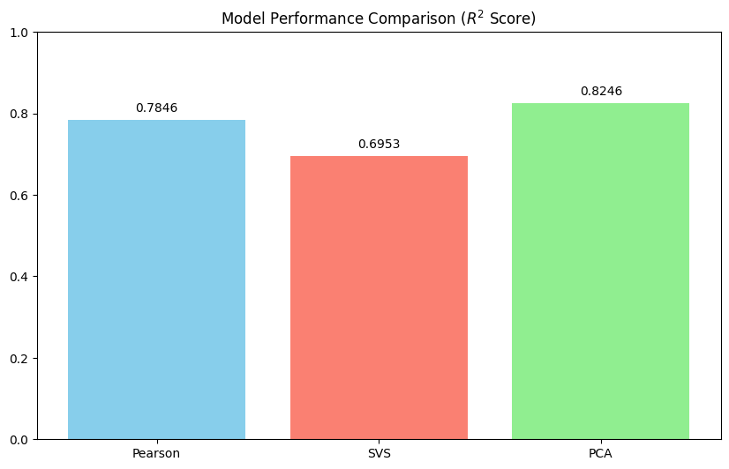
Results : Performance Comparison
Comparison of Feature Weights Across Models
Model Performance Comparison
PCA is the best : OES + VI synergy
What if we construct a subset using
high-impact features from each model?
OES + PC4-15 (VI + Low Variance components)

Slide 18
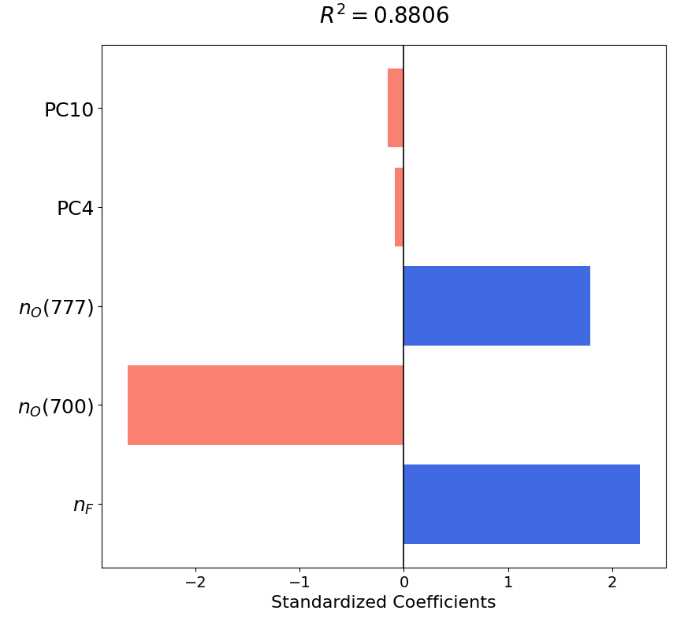
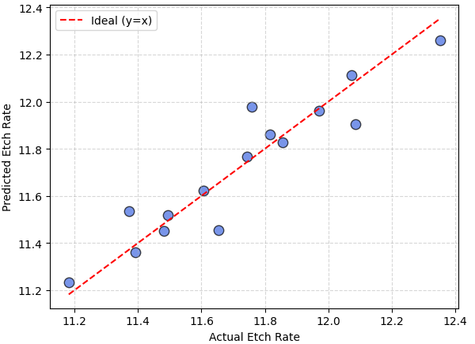
Results : Optimization of Model Performance
Proposed Feature Subset
Validation of Hybrid Model
PC variables capture subtle process variations by incorporating VI data.
Model accuracy is enhanced by weighting the dominant radical density onto the PCs that distribute the variance (explanatory power).

Slide 19
Discussion
Proposed Hybrid Model for Etch Rate Prediction
Sensor Fusion: Chemical-Physical Synergy
Pearson : 0.7846
OES (Potential rate)
SVS : 0.6953
Hybrid : 0.8806
PCA : 0.8246
VI (Process efficiency)
Mechanism Verification
Role of F radicals
F + Si → SiF₄ ↑
n_{F} (+) weight, main factor
  Actinometry validity
Robust prediction by OES+VI data, validated by the F radical's positive correlation with etch rate

Slide 20
Discussion
Proposed Hybrid Model for Etch Rate Prediction
Dual Impact of O₂ Addition
n_{O}(777.03nm) : (+)
​n_{O}(700.65nm) : (-)
Trade-off
Scavenging Effect
Inhibition Effect
Role of Latent PC Variables
PC4 (Macro-scale)
Control (Pressure / RF Power)
PC10 (Micro-scale)
Residual Correction
Mastering non-linear process by decoding the dual role of oxygen and PC variables for macro-micro adjustments

Slide 21

Conclusion
연구 주제 : 예측 정확도를 높인 VM 모델 구축
최종 유도 모델(PCA) : 5개의 변수, R²= 0.8806
연구 의미
Actinometry
+ Ar Line-ratio
+ VI sensor
→ 변수 생성
PCF, SVS, PCA
→ Top5 feature 조합
예측 성능을 높인
MLR 모델 생성
결정계수 평가
최종​모델 도출
OES (Chemical Quantity)
VI (Physical Quality)
Black Box Explainable
Resolving VM uncertainty through PC variable analysis using OES and VI sensor data.

Slide 22
Suggestion
Proposal Based on the Unresolved Issues
이전 연구의 문제
후속 연구 제안​
플라즈마 내부 반응 메커니즘 비선형성
Extreme Learning Machine(ELM)
회귀계수의 해석 안정성 저하
Hidden Layer Mapping
PCA 모델의 예측 오차
Run-to-Run Online Learning
적은 데이터 수로 딥러닝 불가능
PCA + ELM Hybrid
ELM model using PCA feature selection for real-time monitoring with higher accuracy and analysis possibility.

Slide 23
References
Jang, Y., Roh, H.-J., Park, S., Jeong, S., Ryu, S., Kwon, J.-W., Kim, N.-K., & Kim, G.-H. (2019). Characteristics of a plasma information variable in phenomenology-based, statistically-tuned virtual metrology to predict silicon dioxide etching depth. Current Applied Physics, 19, 1068-1075.
Kim, G., Kwon, J.-W., Lee, I., Seo, H., Park, J.-B., Shin, J. -H., & Kim, G. -H. (2024). Application of plasma information-based virtual metrology (PI-VM) for etching in C4F8/Ar/O2 plasma. IEEE Transactions on Semiconductor Manufacturing.
Maitra, V., Su, Y., & Shi, J. (2024). Virtual metrology in semiconductor manufacturing: Current status and future prospects. Expert Systems With Applications, 249, 123559.
Siepa, S., Tsankov, T. V., Czarnetzki, U., Danko, S., & Mussenbrock, T. (2014). On the OES line-ratio technique in argon and argon-containing plasmas. Journal of Physics D: Applied Physics, 47, 445201.
Coburn, J. W., & Chen, M. (1980). Optical emission spectroscopy of reactive plasmas: A method for correlating emission intensities to reactive particle density. Journal of Applied Physics, 51, 3134-3136.
A. Kramida, Y. Ralchenko, J. Reader, Nist Atomic Spectra Database Version 5.4, (2016) http://physics.nist.gov/asd , Accessed date: 2 January 2025.
Yang, R., & Chen, R. (2010). Real-time plasma process condition sensing and abnormal process detection. Sensors, 10(6), 5703-5723.
Abe, H., Yoneda, M., & Fujiwara, N. (2008). Developments of plasma etching technology for fabricating semiconductor devices. Japanese Journal of Applied Physics, 47(3R), 1435-1455.
Global Market Insights. (n.d.). Semiconductor metrology and inspection market size, share & trends analysis report. Retrieved from https://www.gminsights.com/industry-analysis/semiconductor-metrology-and-inspection-market
McKinsey & Company. (n.d.). Semiconductors have a big opportunity, but barriers to scale remain. Retrieved from https://www.mckinsey.com/industries/semiconductors/our-insights/semiconductors-have-a-big-opportunity-but-barriers-to-scale-remain
Advantest. (n.d.). ACS white paper: Real-time data infrastructure (RTDI) [White paper]. Retrieved from https://www.advantest.com/document/en/products/acs/rtdi/ACS_white_paper.pdf

