Slide 1

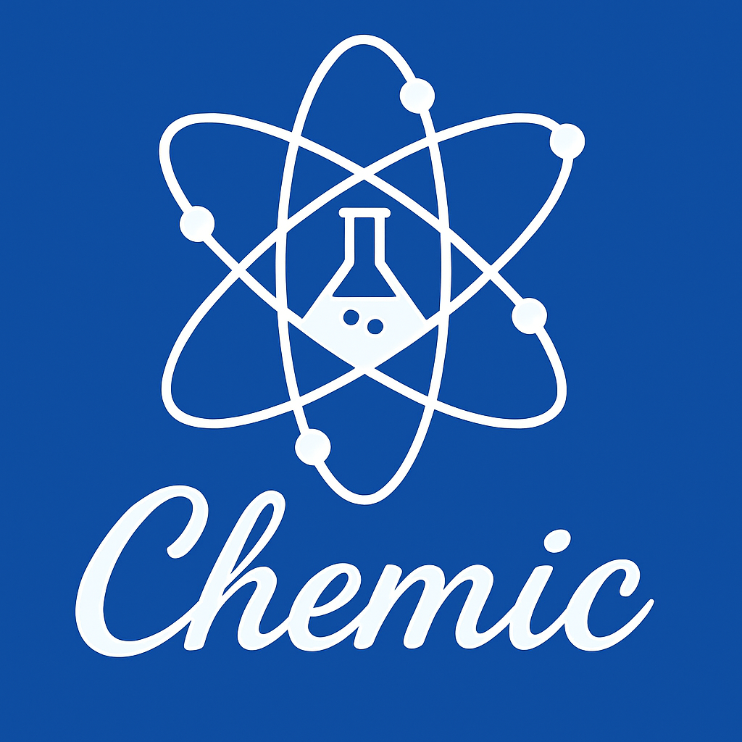
Stealth Nanocarriers in Carcer Therapy
: PEGylation and Its Evolution
2025 Spring Semester CHEMIC Seminar
CHEMIC 생화학 1조
노하은 유민주 윤승수 이연수 이지훈 이효세
2025.06.04
Sungkyunkwan University
School of Chemical Engineering

Slide 2
01 Introduction
02 Nanomedicine
03 PEG
04 Limit of PEG
05 PEG Alternatives
06 Conclusion
Contents

Slide 3
01 | Introduction to Nanomedicine
Sungkyunkwan University
School of Chemical Engineering
Nanomedicine
"an offshoot of nanotechnology, which refers to highly specific medical interventions at the molecular scale for curing disease or repairing damaged tissues, such as bone, muscle, or nerve"
National Institute of Health

Slide 4
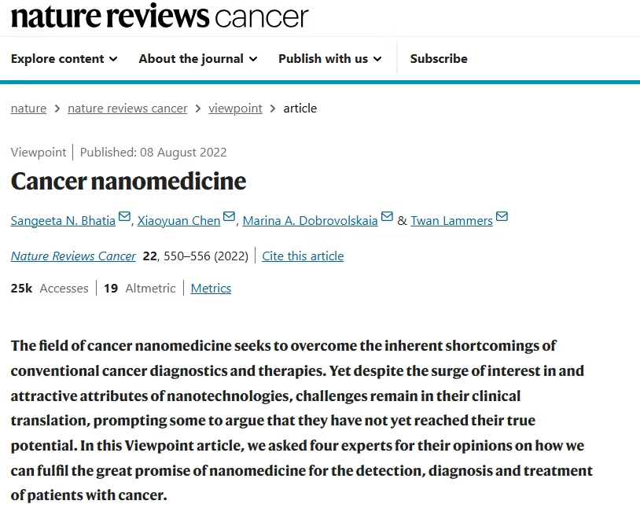
01 | Introduction to Nanomedicine
Sungkyunkwan University
School of Chemical Engineering
What are nanoparticles?
  Submicron-sized particles (1–100 nm)
  Engineered for drug delivery, diagnostics, etc.
Why nanoparticles in medicine?
  Targeted delivery, controlled release, reduced toxicity
Classification
  Based on material: lipid, polymer, inorganic
  Based on function: passive/active targeting, responsive release

Slide 5
01 | Introduction to Nanomedicine
Sungkyunkwan University
School of Chemical Engineering
Classification of Nanomedicine by Function
• Passive Targeting
- Nanoparticles accumulate in tumor tissues via the Enhanced Permeability and Retention
(EPR) effect.
- This utilizes leaky vasculature and poor lymphatic drainage in diseased tissues.
• Active Targeting
- Surface ligands on nanoparticles bind to specific receptors on target cells.
- This improves selectivity and enhances cellular uptake through receptor-mediated endocytosis.
• Stimuli-Responsive Release
- Drugs are released in response to internal (e.g., pH, enzymes) or external (e.g., heat, light) triggers.
- This allows for precise, site-specific drug delivery and reduces side effects.

Slide 6
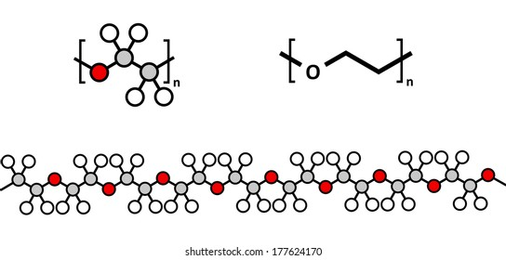
01 | Introduction to Nanomedicine
Sungkyunkwan University
School of Chemical Engineering
Why PEG
• Why We Focused on PEG?
- PEG (Polyethylene glycol)
- Widely used to create "stealth" nanoparticles
- FDA Approved
• Some Questions about PEG
- How does PEG evade the immune system?
- How does PEG become immunogenic?
- How can we prevent antibody formation?

Slide 7
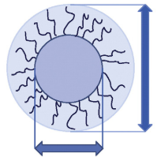
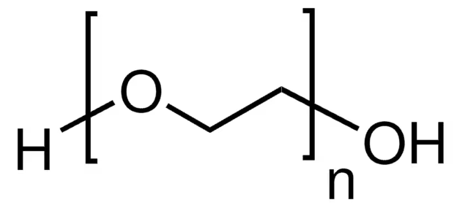
03 | PEG
Sungkyunkwan University
School of Chemical Engineering
Characteristics of PEG
1) Conformational Cloud의 형성
• dynamic, hydrated layer formed by flexible PEG chains attached to nanoparticles
• 원리
- PEG chains are highly flexible (-CH₂CH₂O-) and hydrophilic
- In aqueous environments, they fluctuate and extend, forming a cloud-like shell
• Key Functions
- Stealth effect: Repels proteins, evades immune detection
- Barrier layer: Slows drug release from nanoparticle core

Slide 8
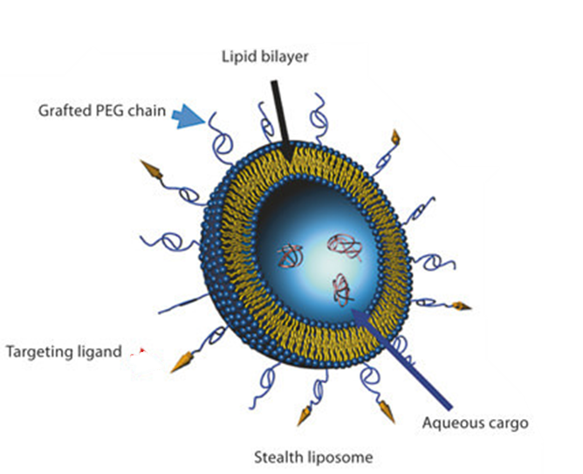
03 | PEG
Sungkyunkwan University
School of Chemical Engineering
Characteristics of PEG
2) Stealth effect 형성(면역 회피)
Steric Repulsion
→ 혈액 내 단백질(Opsonine, Compliment)이나 면역세포(대식세포)와 약물의 직접적인 접촉을 막음
Form of Hydration Layer
→ 사슬 주변에 수화층을 형성하여 면역세포의 인식을 방해
Dynamic Motion
→ 단백질이 표면에 고정되기 어렵게 만들며, 에너지적으로 결합을 불리하게 만듦
▲ Stealth liposome

Slide 9
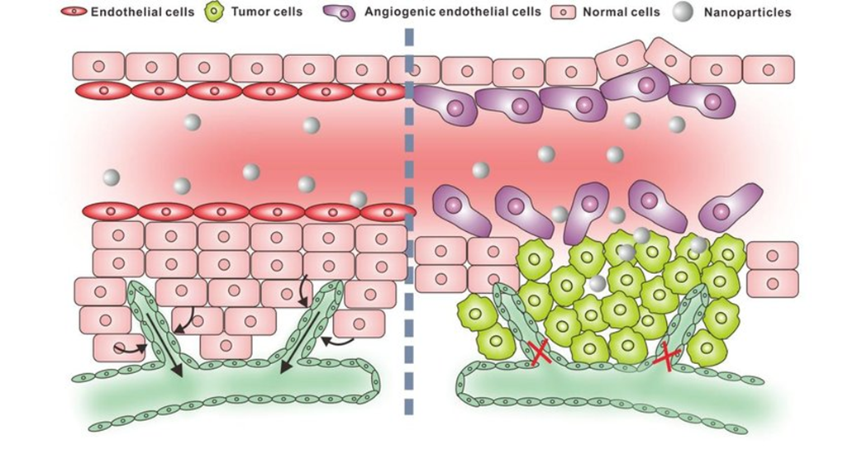
03 | PEG
Sungkyunkwan University
School of Chemical Engineering
Characteristics of PEG
+) EPR Effect(Enhanced Permeability and Retention)
• EPR 효과 : 종양 조직에서 나노 입자 약물이 더 잘 축적되는 현상
• 원리
- 종양 주변 혈관은 급속도로 성장 → 느슨하고 틈이 많음 (투과성 ↑)
→ 나노 입자 (10-200nm)가 틈 사이로 쉽게 빠져나와 종양 내부로 들어갈 수 있음.
- 종양 조직은 림프 배출이 거의 없어 나노 입자가 오래 머물 수 있음
• EPR + PEG(Prolonged Circulation) => great effect
EPR effect ▶

Slide 10
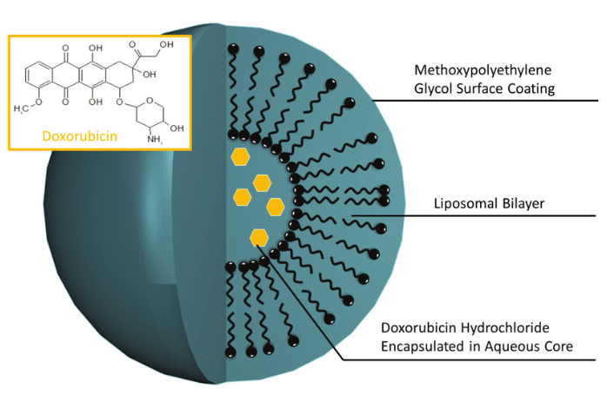
03 | PEG
Sungkyunkwan University
School of Chemical Engineering
Real World Application of PEG
Doxil® - First FDA Approved Nanomedicine
→ Prolonged drug circulation time due to PEGylated nano-liposome
→ Passively targeted to tumor cells due to the EPR effects
Y. Barenholz et al.,
Doxil®
(PEGylated doxorubicin HCl Liposome Injection)

Slide 11
03 | PEG
Sungkyunkwan University
School of Chemical Engineering
Anti-PEG Immunogenesis
1. Immune detection: T Cell Dependent
2. T cell Independent (TI) antigen recognition of PEG
3. Formation of Anti-PEG antibodies: IgM, IgG development
4. ABC phenomenon: Accelerated Blood Clearance

Slide 12
04 | Limit of PEG
Sungkyunkwan University
School of Chemical Engineering
Case of PEG Resistance
Case1. Pegloticase (통풍 치료제)
• uricase + PEGylation → 면역 회피 전략
• 약 38% 환자에서 anti-PEG IgG/IgM 생성
• 치료 효과 저하, 일부 염증 유발
• 항체 생성 환자 = 비반응자 (Non-responder)
Case2. PEG-asparaginase (백혈병 치료 효소)
• 암세포 생존 필수 아미노산 asparagine 분해
• PEGylation으로 면역 반응 억제
• 일부 환자에서 anti-PEG 항체 생성 → 약물 저항성 (resistance)

Slide 13
04 | Limit of PEG
Sungkyunkwan University
School of Chemical Engineering
Case of PEG Resistance
Case3: Pegnivacogin (항응고제)
• 첫 투여 시 아나필락시스 발생 사례 존재
• 기존 anti-PEG 항체 보유 환자에서 주로 발생
• PEG는 비면역원성이 아님 → 첫 투여에서도 위험
Problems
(1) 항체 생성 (IgM/IgG)
(2) 보체 활성화 (C1q → C3 → MAC)
(3) 세포 손상, 약물 유출 → 효과 저하, CARPA 유발 가능

Slide 14
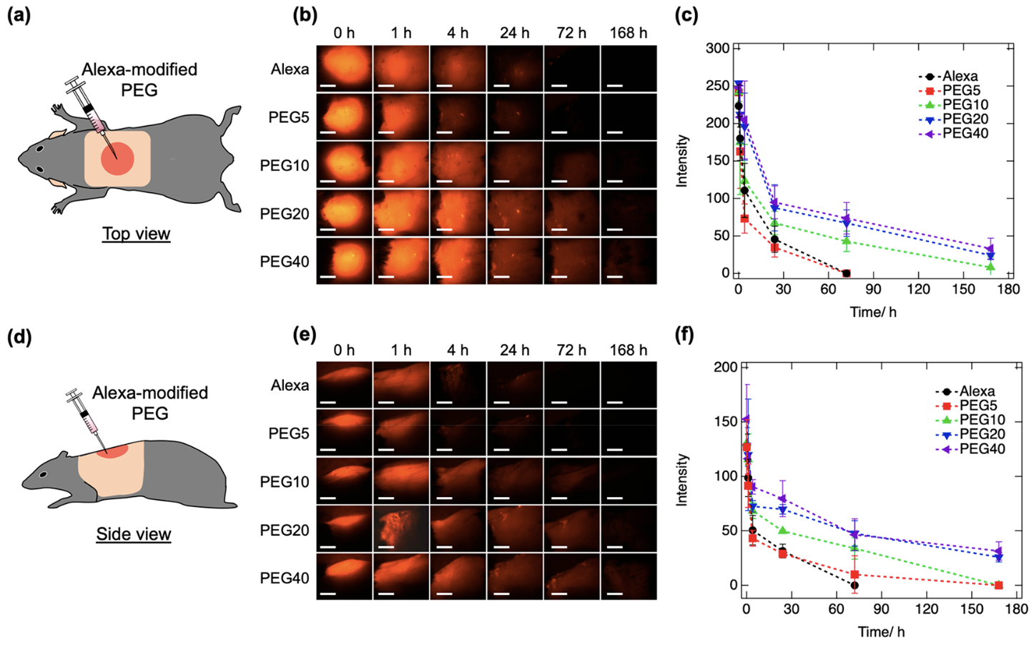
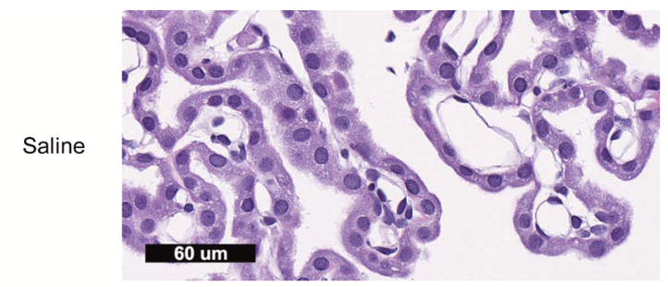
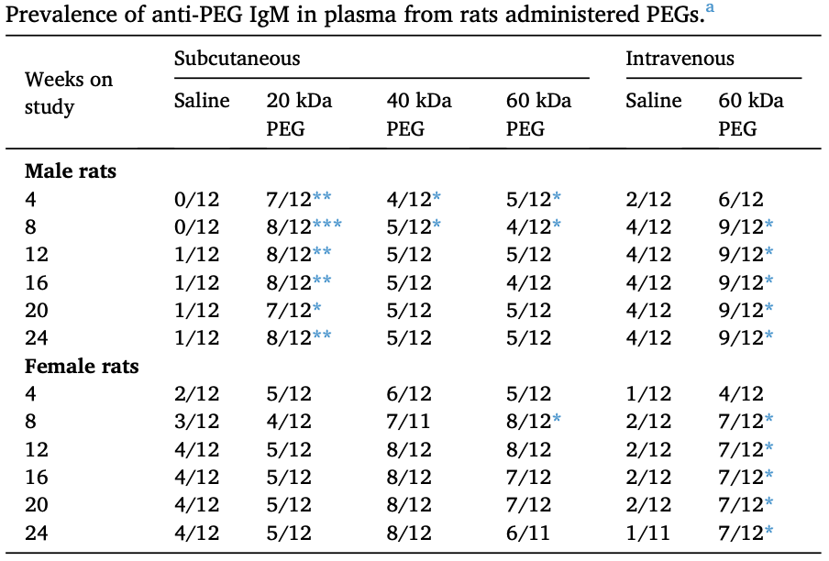
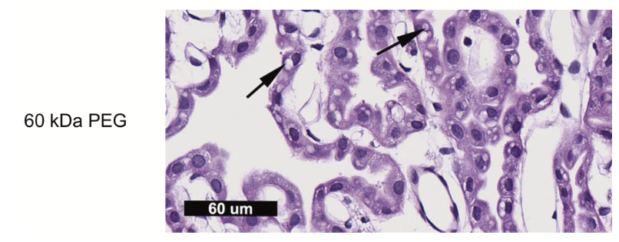
04 | Limit of PEG
Sungkyunkwan University
School of Chemical Engineering
Lack of Biodegradability
저분자량 PEG
크기가 작기 때문에 신장을 통해 빠르게 배설
너무 빨리 체외로 나가 지속 시간이 짧아지고 약효가 떨어지는 문제 발생
고분자량 PEG
신장에서 배설이 잘 되지 않아 축적될 수 있음
→ 리소좀에 쌓여서 공포화(vacuolization) 유발, 항-PEG 항체 생성되어 약물에 대한 면역학적 거부 반응 가능성

Slide 15
05 | PEG Alternatives
Sungkyunkwan University
School of Chemical Engineering
Requirements:
1. Biodegradable or readily eliminable:
무해한 byproduct로 분해되거나, 체내 축적을 방지하게끔 배설되어야 함.
2. Low immunogenicity:
기존 항체에 인식되어서는 X, 보체 활성화 or 새로운 항체 생성 최소화할 것.
3. Effective ‘stealth’ properties:
hydrophilic & flexible coating 형성 → opsonization 억제, RES 흡수 지연, PEGylation에 필적하는 순
환 시간 유지
4. Efficient drug delivery:
코팅은 약물 방출 또는 표적 부위 축적을 방해해서는 안 됨. → 질병 부위의 표적화 또는 세포 흡수 향상
(e.g. 자극 반응 기능을 통해)

Slide 16
05 | PEG Alternatives
Sungkyunkwan University
School of Chemical Engineering
Stealth Polymer | Biodegradability | Immune Response (Anti-polymer antibodies, etc.) | Stealth Performance (Circulation & RES evasion)
PEG (reference) | No | Induces anti-PEG IgM/IgG in many patients | Excellent in First dose
Polysarcosine (pSar) | Yes | Minimal Immunogenicity | Similar to PEG
Poly(2-oxazolines) (POX) | Partially | Low | Excellent
Poly(phosphoesters) | Yes | Biocompatible | Excellent
Hyperbranched Polyglycerol (HPG) | No | Non-Immunogenetic | Excellent
PLGA | Yes | Excellent Biocompatibility Minimal Immune reactions | Weaker than PEG

Slide 17
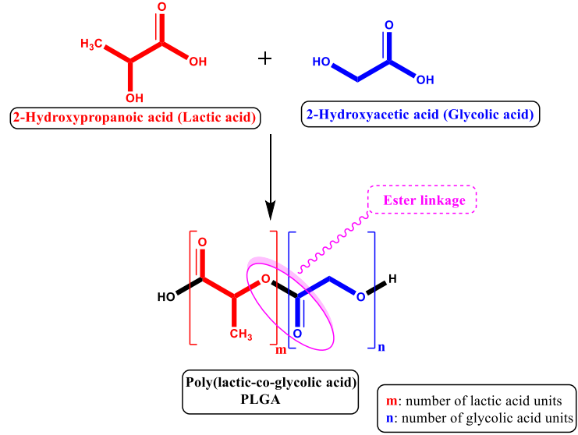
05 | PEG Alternatives
Sungkyunkwan University
School of Chemical Engineering
PLGA
Poly(Lactic-co-Glycolic Acid)
Excellent biocompatibility, controlled release, and drug protection
Degrades into lactic and glycolic acid – Safely Metabolized
FDA Approved
PEG-PLGA Blockcopolymer
Advantages from PEG : stealth property, tumor accumulation via EPR effects
Advantages from PLGA : non-immunogenic, controlled release
⇒ PEG-PLGA 나노입자는 약물 운반체로서 큰 잠재력을 가짐
▲ Conformation of PLGA

Slide 18
05 | PEG Alternatives
Sungkyunkwan University
School of Chemical Engineering
PEG-PLGA vs PEG
Side Effect | PEG-PLGA Effect | Eliminated?
ABC phenomenon | Still occurs, especially with repeated dosing | No
Anti-PEG antibodies | PEG is still exposed on the surface | Partially
Hypersensitivity reactions | Reduced in some reports, but not absent | Partially
Non-biodegradability | PLGA part degrades fully, lower Mw of PEG | Yes

Slide 19
06 | Conclusion
Sungkyunkwan University
School of Chemical Engineering
1. 면역 내성 문제점 해결
PEG로 표면을 개질한 PLGA NPs는 비PEG화 된 것보다 다발성 경화증 증상을 개선시켜 면역 내성 향상 가능성을 보여줌
2. 암 치료 분야의 연구 성과
삼중음성 유방암 치료에서 PLGA-PEG 몰리머 마이크로스피어를 사용한 연구에서 표적 항암약물을 성공적으로 캡슐화하여 독성과 부작용을 줄이면서 치료 효과를 개선함
PEG-PLGA 나노입자는 PSMA를 발현하는 전립선암 세포에 선택적으로 결합하여, 비기능화된 나노입자에 비해 3.77배 높은 종양 축적을 보임
3. 약물 전달 시스템에서의 효과
PLGA 나노입자에 PEG 코팅을 적용하면 표면의 친수성 특성이 증기하고 혈류 내 체류 기간이 연장되며, 약물 운반 매체로서의 우수한 잠재력을 제공
PEG-PLGA 나노입자 구조는 친수성 및 소수성 약물 성분을 모두 안정적으로 탑재할 수 있음

Slide 20
06 | Conclusion
Sungkyunkwan University
School of Chemical Engineering
Future Research
Stealth property and Immunogenicity depends on PEG/PLGA proportion?
pH or enzyme-responsive PEG-shedding strategies to reduce immune recognition while maintaining prolonged circulation time.
Investigate formulation stability, scale-up reproducibility, and regulatory pathways that limit the clinical approval of next-gen stealth nanoparticles.
Study how patient-specific immune profiles affect the performance of PEGylated drugs and explore adaptive delivery systems.

Slide 21
07 | References
Sungkyunkwan University
School of Chemical Engineering
[1] Allen, T. M. et al., "Stealth liposomes: Basic science and rationale for clinical applications," Pharmacol. Rev., 1999.
[2] Cheng, J. et al., "Formulation of functionalized PLGA-PEG nanoparticles for in vivo targeted drug delivery,"
Biomaterials, vol. 28, no. 5, pp. 869–876, 2007.
[3] Fang, J. L. et al., "Toxicity of high-molecular-weight polyethylene glycols in Sprague Dawley rats," Toxicol. Lett.,
vol. 359, pp. 22–30, 2022.
[4] Gao, Y., Li, Y., Guo, Y., Liu, X., and Zhao, W., "Drug-encapsulated blend of PLGA-PEG microspheres: In vitro and in
vivo study of the effects of localized/targeted drug delivery on the treatment of triple-negative breast cancer,"
Sci. Rep., vol. 10, Art. no. 13355, 2020.
[5] He, C. et al., "POx/POz-lipid alternatives to PEG-lipids in mRNA LNPs," Biomacromolecules, vol. 25, no. 8, pp.
4734–4747, 2024.
[6] H. O. Alsaab et al., "PLGA-Based Nanomedicine: History of Advancement and Development in Clinical
Applications of Multiple Diseases," Pharmaceutics, vol. 14, no. 12, p. 2728, Dec. 2022.
[7] Hoang Thi, T. T. et al., "Review of PEG immunogenicity and alternatives," Polymers, vol. 12, no. 2, Art. no. 298,
2020.
[8] Hu, Q., Luo, Y., Xue, Y., Zhang, H., and Ding, Y., "Polyethylene glycol (PEG)-based polymer–drug conjugates: From
linear PEGs to multiarm PEGs," Pharmaceuticals, vol. 14, no. 3, Art. no. 221, 2021.
[9] Ishikawa, S. et al., "Molecular weight-dependent diffusion, biodistribution, and clearance behavior of tetra-
armed poly(ethylene glycol) subcutaneously injected into the back of mice," ACS Macro Lett., vol. 12, no. 4, pp.
510–517, 2023.

Slide 22
07 | References
Sungkyunkwan University
School of Chemical Engineering
[10] Kon, E. et al., "Polysarcosine coating evades ABC phenomenon," J. Control. Release, vol. 327, pp. 406–420, 2020.
[11] Li, M. et al., "Poly(carboxybetaine) coated liposomes avoid ABC and enhance tumor delivery," Theranostics, vol.
5, no. 6, pp. 583–596, 2015.
[12] Moghimi, S. M., Parhamifar, L., Ahmadvand, D., Wibroe, P. P., Andresen, T. L., Farhangrazi, Z. S., and Hunter, A. C., “
Particulate systems for targeting of macrophages: Basic and therapeutic concepts," J. Innate Immun., vol. 4, no. 5
–6, pp. 509–528, 2012.
[13] “PEG Alternatives You Should Be Thinking About,” BioProcess Online, 2023. [Online].
[14] Xie, X. et al., "Challenges and opportunities from basic cancer biology for nanomedicine for targeted drug deliver
y," Curr. Cancer Drug Targets, vol. 18, no. 7, pp. 636–653, 2018.
[15] Y. Barenholz, "Doxil®--the first FDA-approved nano-drug: lessons learned," Journal of Controlled Release, vol.
160, no. 2, pp. 117–134, Jun. 2012.
[16] Zhang, D. et al., "Drug-loaded PEG-PLGA nanoparticles for cancer treatment," Front. Pharmacol., vol. 13, Art. no.
990505, Aug. 2022.
[17] Zheng, Y., Yuan, X., Huang, Y., and Wang, Y., "Liposomal drug delivery systems with pH-responsive polyethylene g
lycol (PEG) shedding," Nanomaterials, vol. 12, no. 21, Art. no. 3869, 2022.

Slide 23
08 | Q&A
Sungkyunkwan University
School of Chemical Engineering
Question?

